Slide 1
Spring Update 2
Dev Bhatia
Ultrafast Optics Laboratory
Boston University College of Engineering

Slide 2
Model Validation
In order to verify that the model does indeed produce an error, the paper results were sought to be reproduced
Utilized the following parameters:
t = 500 ms
ua = 0.502 cm^-1
r = 5 um
R = 43.6 um OR 33.9 um (the paper gives multiple values)

Slide 3
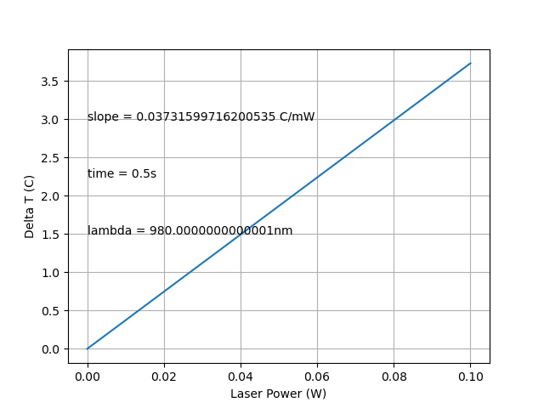
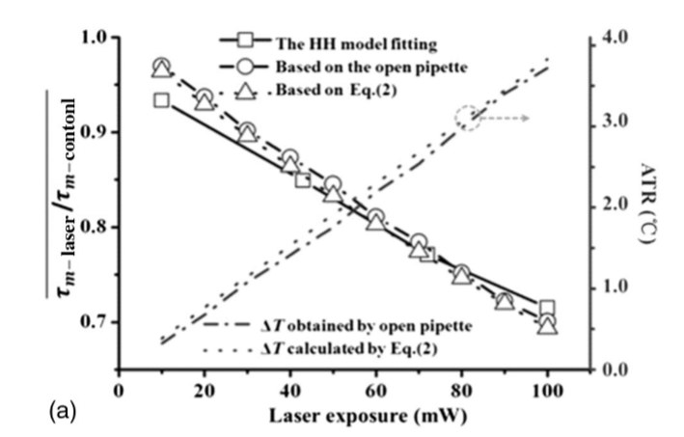
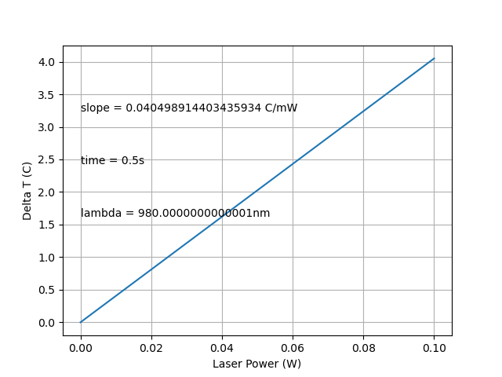
Model Validation (cont.)
Fig 1. ADTR, R = 43.6 um
Fig 2. ADTR, paper
Fig 3. ADTR, R = 33.9 um

Slide 4
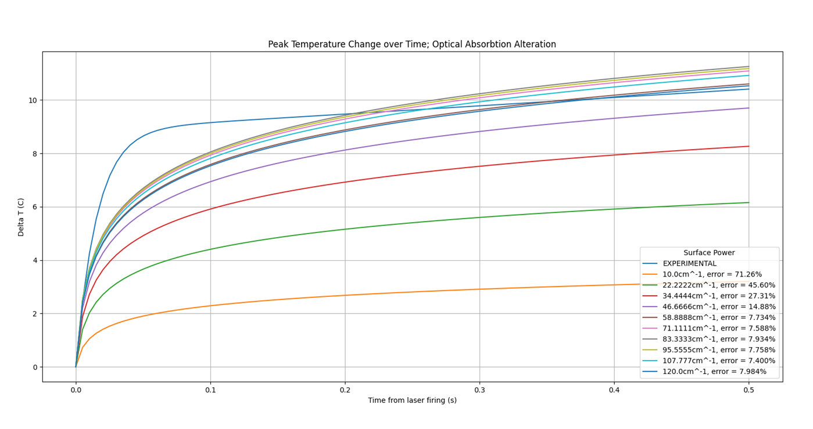
Optical Absorption Coefficient Discrepancies
Increasing the optical absorption coefficient within a reasonable range does not produce a clear trajectory
Fig 4. Erroneous Absorption Coeff

Slide 5
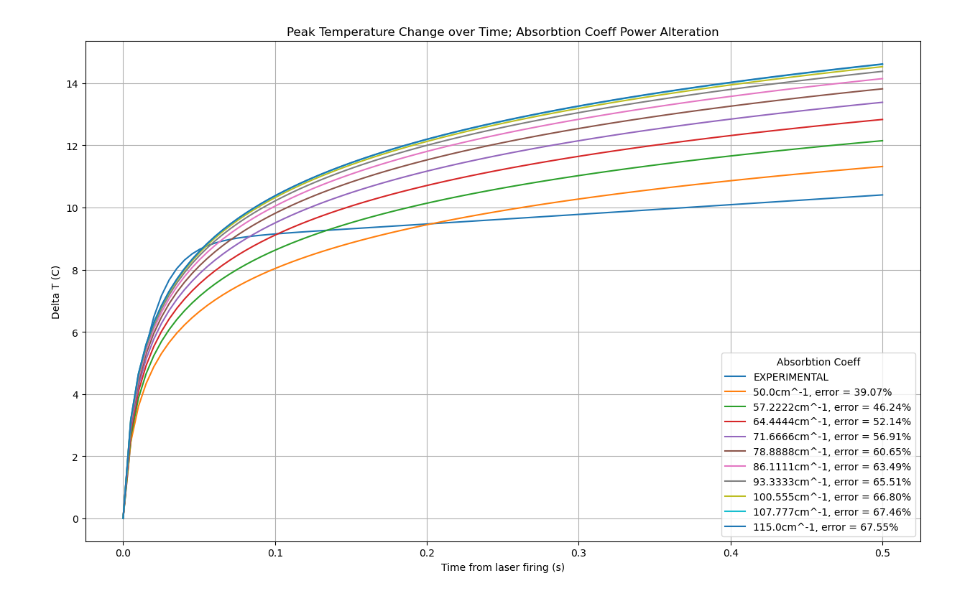
Optical Absorption Coefficient Discrepancies (cont.)
Fig 5. Adjusted OAC

Slide 6
Next Steps
Fit first 20 ms of experimental data in Matlab, reoptimize
Calculate radius considering reflective index
Start sourcing alternative models

Slide 7


Radius Considering Refractive Index
Our model doesn’t currently consider the refractive index of the surface when calculating the radius
The paper gives a simple protocol for calculating it
1.
$$α= \sin^{−1}{\frac{Numerical Aperture}{Refractive Index (fiber)}}$$
2.
$$Z=\left(Radius of fiber\right)\tan{(Fiber tilt)}$$
3.
$$2R=Diameter of fiber core+2Z\tan{α}$$

Slide 8
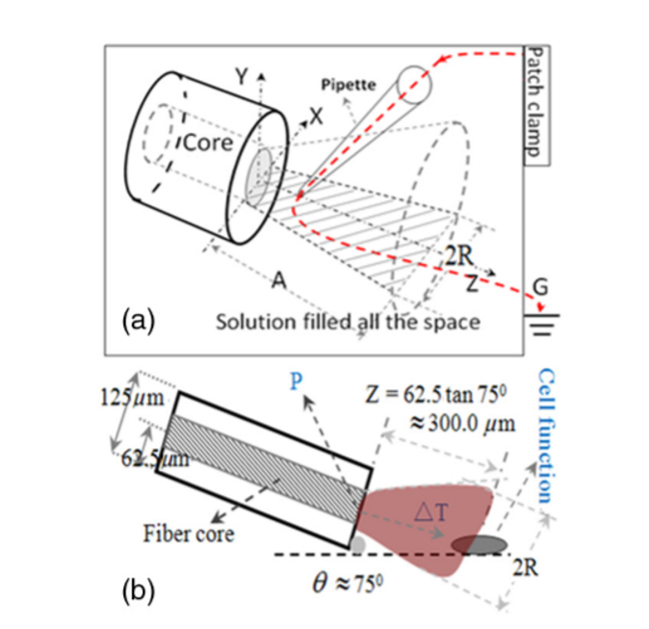
Paper Error & Redundancy
Using the paper’s parameters yields different results than what would be used for the rest of paper
Certain parameters are given, but unused
Refractive index of water

Slide 9


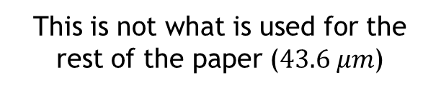
Checking Computations
1.
$$α= \sin^{−1}{\frac{0.14}{1.46}≈5.5°}$$
$$NA=0.14$$
$$Refractive index of fiber=1.46$$
$$Refractive index of water=1.33$$
$$Fiber Radius=62.5 μm$$
$$Fiber Core Diameter=10 μm$$
$$Fiber tilt=75°$$
2.
$$Z=\left(62.5 μm\right)\tan\left(75°\right)=233.25 μm≈300 μm$$
3.
$$2R=10 μm+2\left(300 μm\right)\tan{5.5°} ≈67.8 μm$$
This is not what is used for the rest of the paper ($43.6 μm$)

Slide 10

Attempting to Derive the Alternate Value
This would require the Z – distance to be significantly higher
Utilized the refractive index of water instead of the fiber
$Z ≈365 μm$
$Fiber tilt=80°$
Care should be placed in altering certain parameters
Only changed the measured angle & refractive index

Slide 11
Reoptimizing over the first 20ms

Slide 12
Changes to the Programs / Considerations
An attempt was made to import the experimental data into the existing script
Matplotlib has some interesting quirks when dealing with larger (>50k) data points.
Ended up using the original fitted curve
Refitting the curve proved to not fit any traditional models
Used the original fitted curve, shortened to the first 20ms

Slide 13
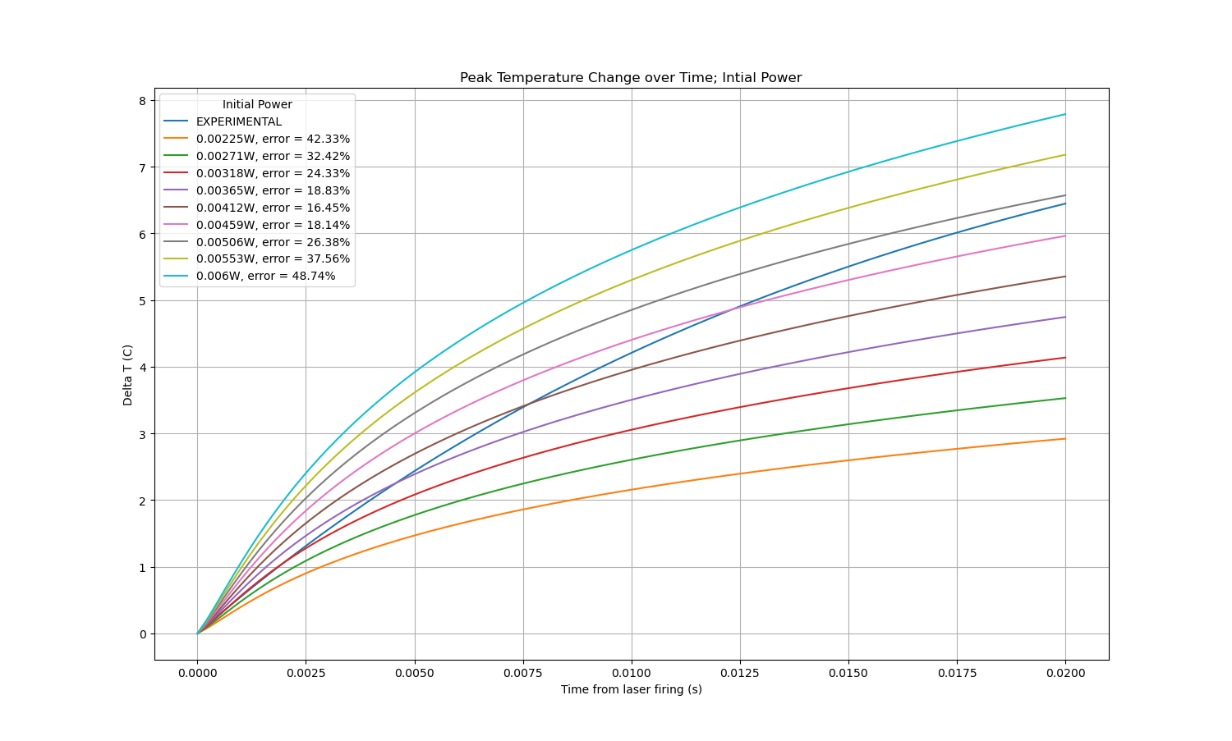

Slide 14
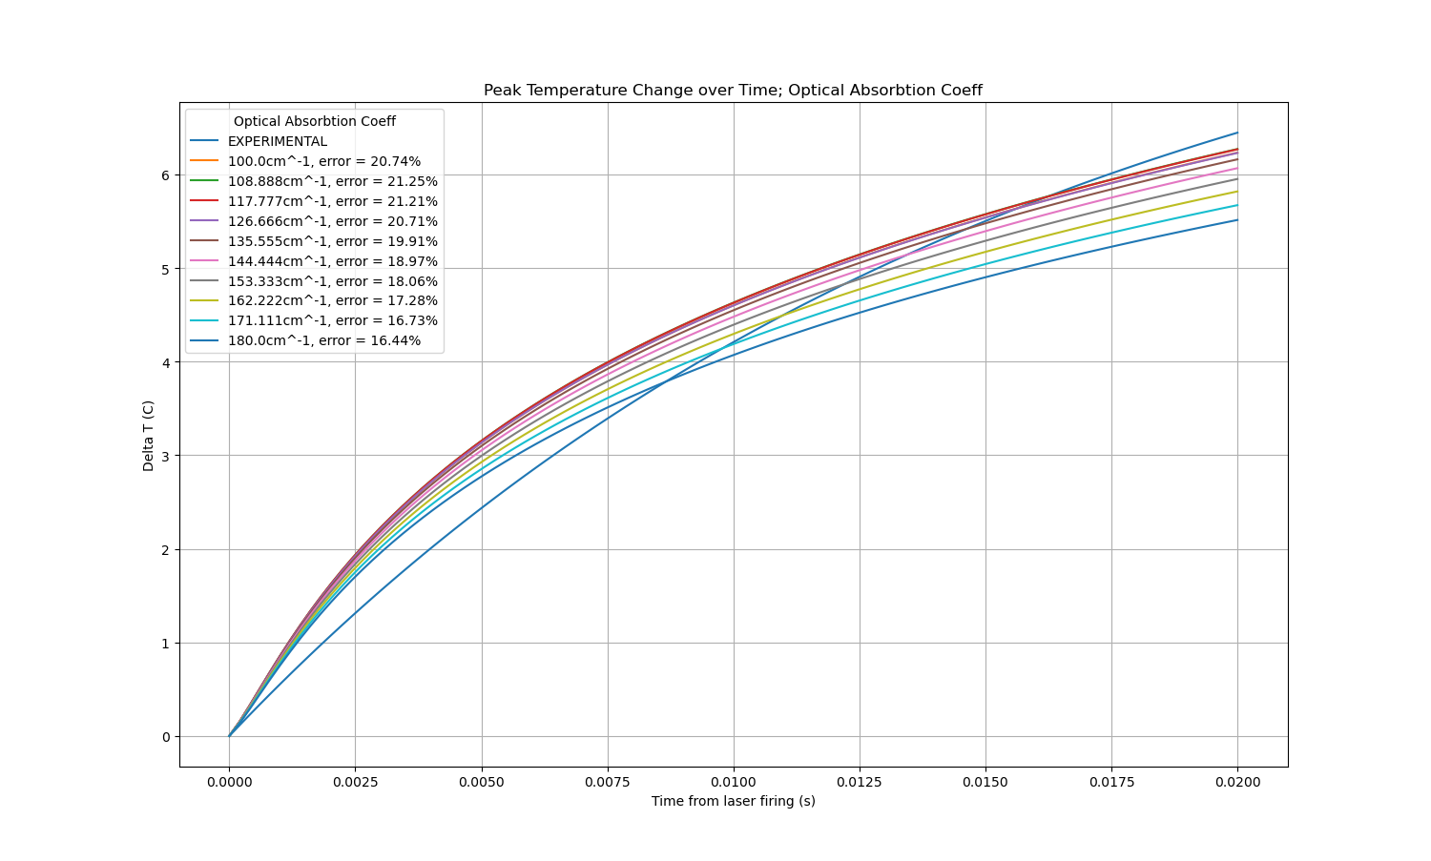

Slide 15
Brief Paper Analysis
Marti, Dominik, Aasbjerg, Rikke N, Andersen, Peter E, & Hansen, Anders K. (2021). MCmatlab: an open-source, user-friendly, MATLAB-integrated three-dimensional Monte Carlo light transport solver with heat diffusion and tissue damage (Erratum). Journal of Biomedical Optics, 26(1), 019804–019804. https://doi.org/10.1117/1.JBO.26.1.019804

Slide 16
Overview
The group introduces a Monte Carlo program for solving the radiative transfer equation in biological tissues
Calculates the distribution of light within the tissue, described by the solution to the RTE
Utilizes Matlab to provide an easily-accessible gui to interpret the tool

Slide 17

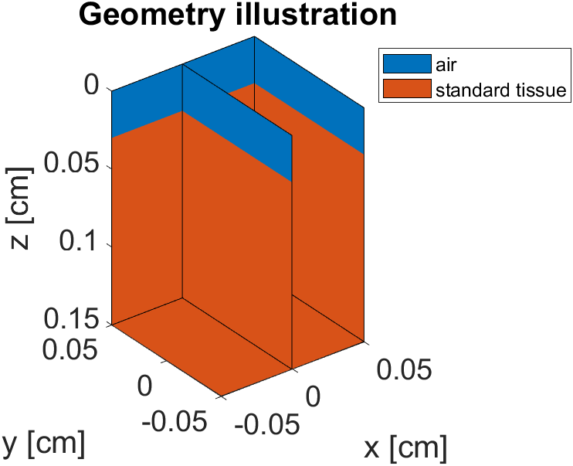
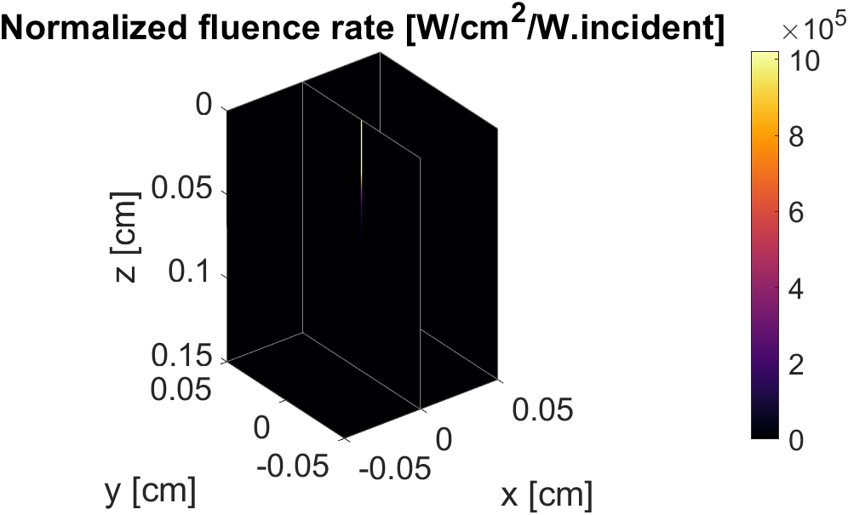
Test Run – “Standard Tissue”

Slide 18
Implications
The geometry of the figure seems to be easily configurable
Could lead to better ways of analyzing the beam radius and its effect on the axonal surface
Full paper analysis enroute

